Slide 1
Final Progress Report
Mar, 7th 2021
Group 6
Yiming Ni
Yin Jin
Ziyuan Zhou

Slide 2
Result summary for this week
 | Baseline | Text Score | Likes Score | Image Score
Gender | 0.59 | 0.69 | 0.76 | 0.84 (on Val)
Age Group | 0.59 | 0.61 | 0.64
Open(RMSE) | 0.65 | 0.60 | 0.63
Conscientious(RMSE) | 0.73 | 0.68 | 0.72
Extrovert(RMSE) | 0.79 | 0.79 | 0.78
Agreeable(RMSE) | 0.66 | 0.67 | 0.66
Neurotic(RMSE) | 0.80 | 0.80 | 0.78
Notes:
Let me show you guys about individual training result of this week.I will give you a short presentation about what I did for this week

Slide 3
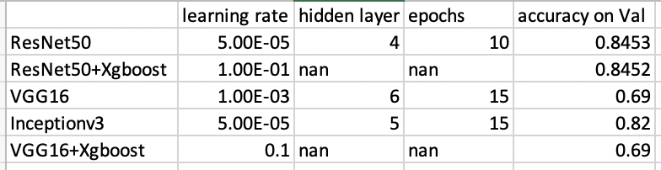
Image:
FOR Gender Binary Classification:
State of art model for feature extraction: RestNet50, VGG16, Inception v3
Built my own MLP, XGboost
Fine tuning on hyper parameters
Summary

Slide 4
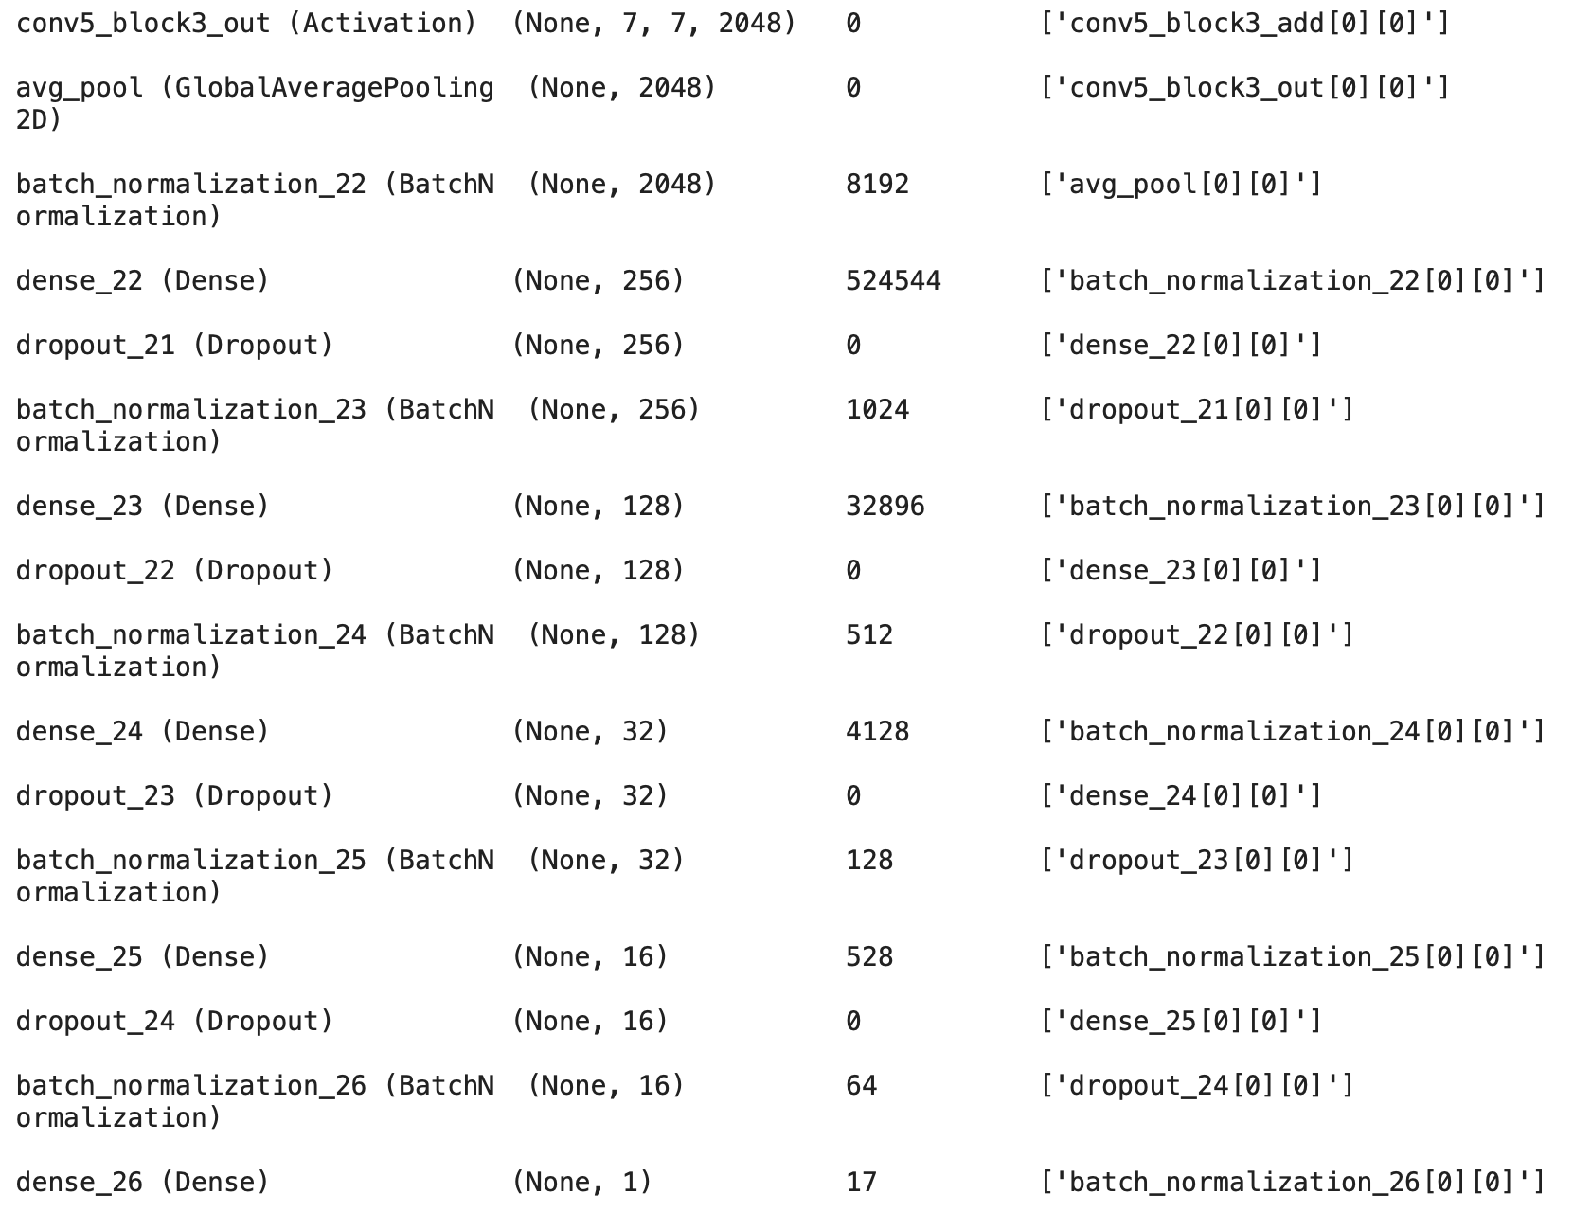
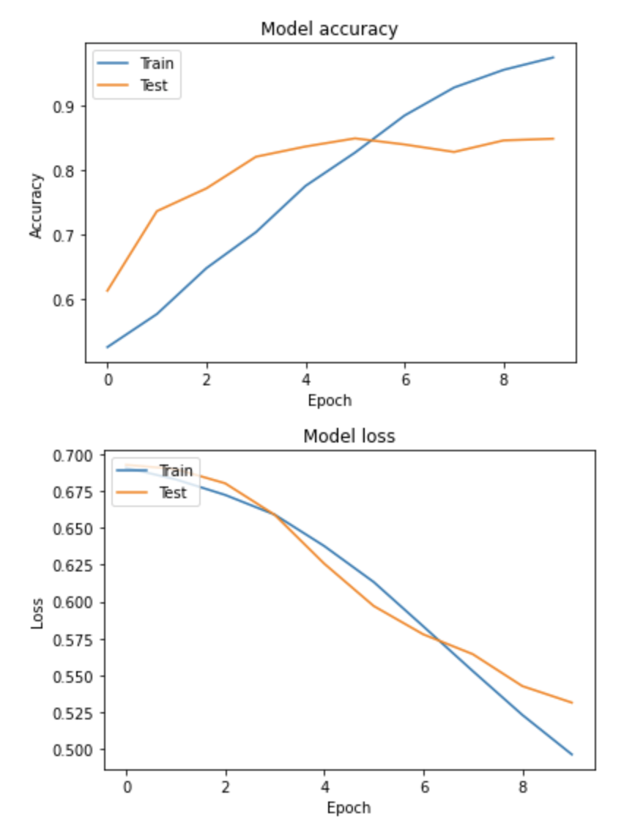
Resnet50+MPL

Slide 5
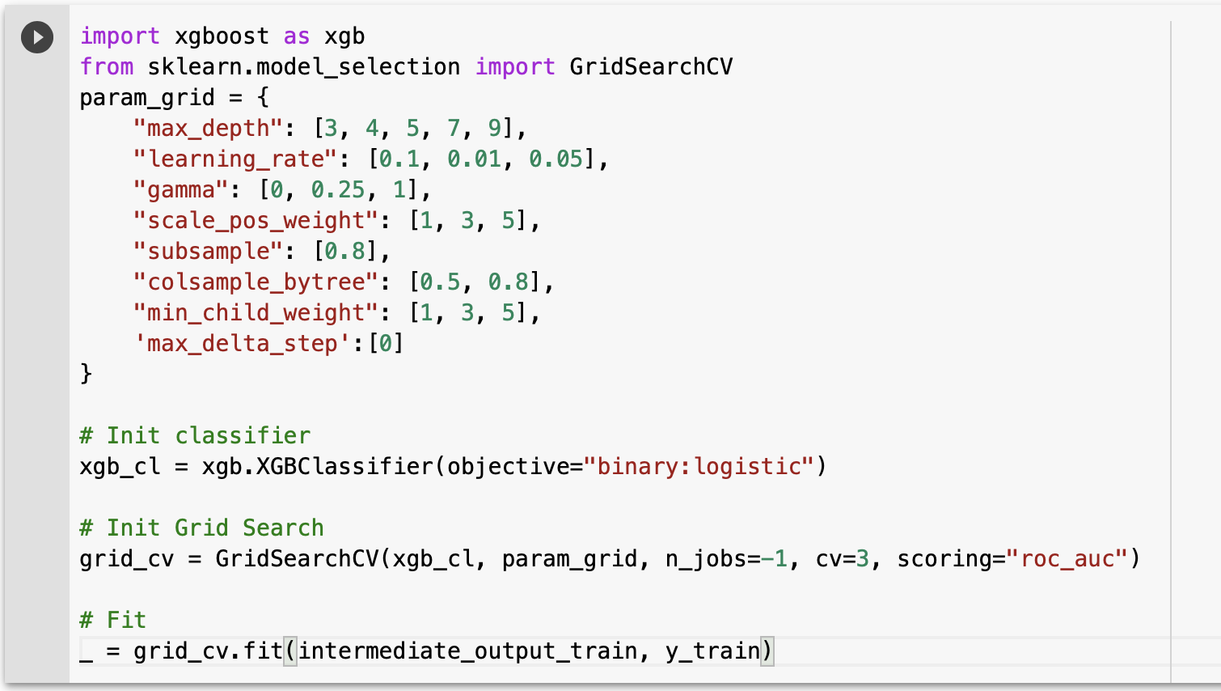
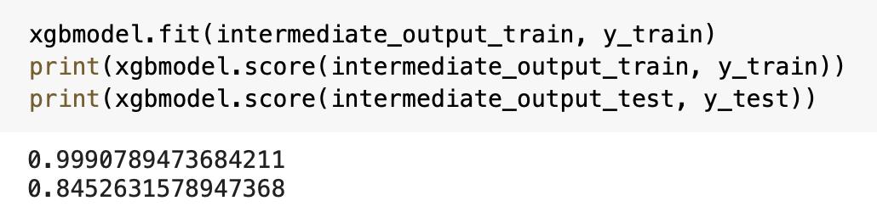
Restnet50+XGboost

Slide 6
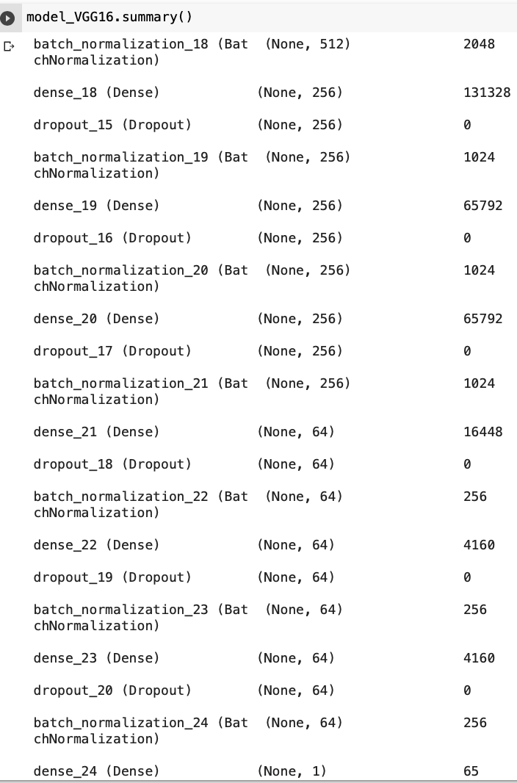
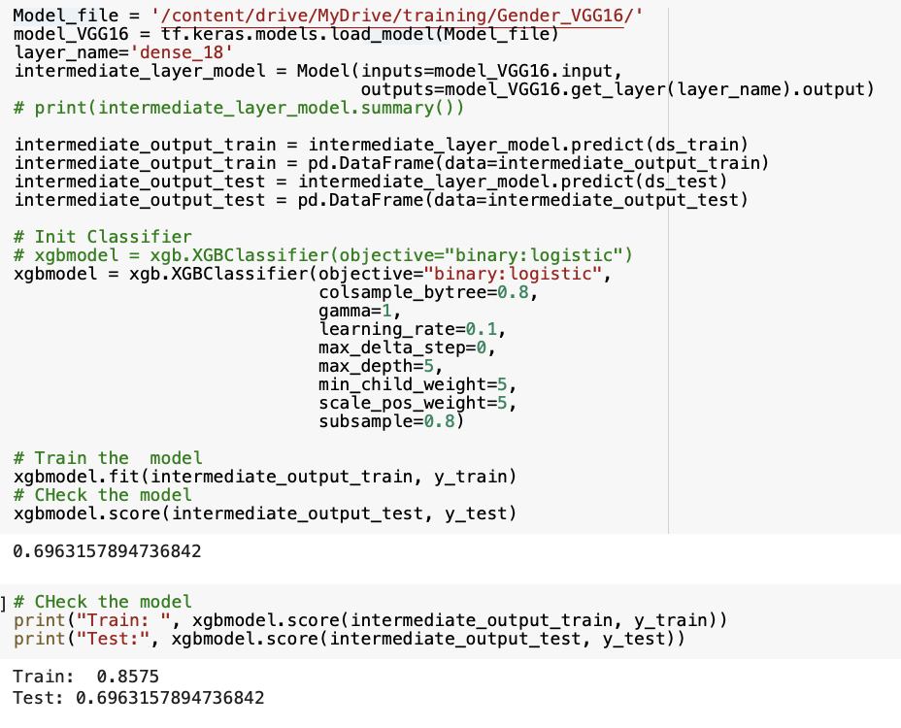
VGG16

Slide 7
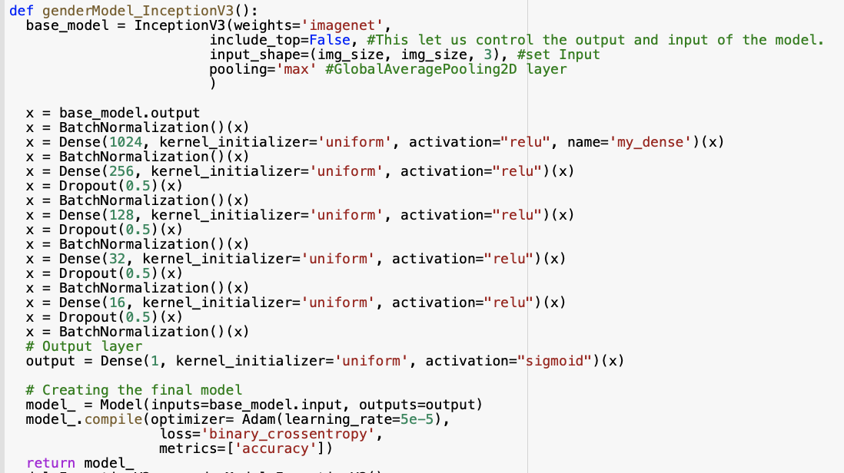
InceptionV3： MLP

Slide 8
Future Suggestion
Fine tune base on state of art models in Keras:
https://keras.io/api/applications/
Suggestion for built own MLP
https://www.datacamp.com/blog/keras-cheat-sheet-neural-networks-in-python
Convolutional XGBOOST
https://www.kaggle.com/chekoduadarsh/starters-guide-convolutional-xgboost
Fine tune XGboost by using GridSearch
https://www.analyticsvidhya.com/blog/2016/03/complete-guide-parameter-tuning-xgboost-with-codes-python/

Slide 9
Text
What I did for these weeks:
Do the text classification with CNN & LSTM models
Use the pre-trained embedding “GloVe” and create a embedding matrix for model’s embedding layer

Slide 10
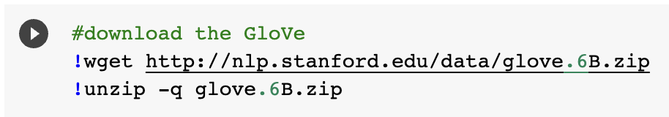
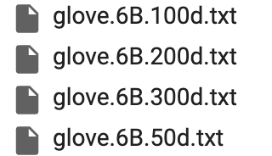
Download the GloVe

Slide 11
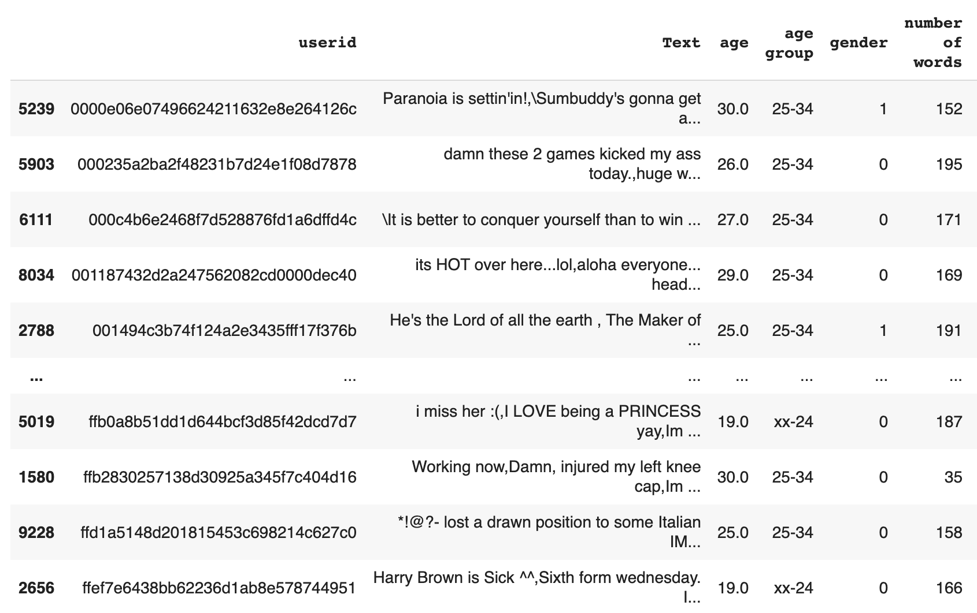
Dataset

Slide 12
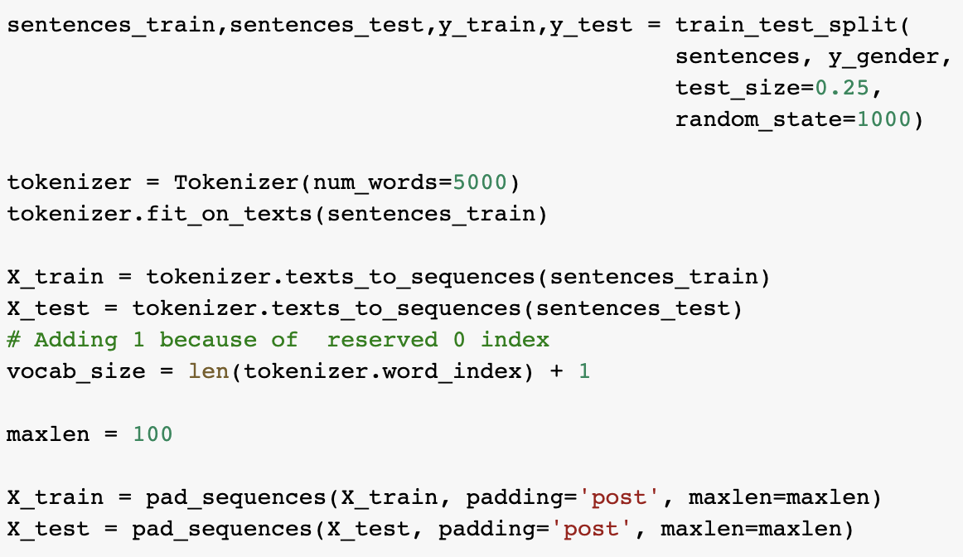
Process the Text

Slide 13
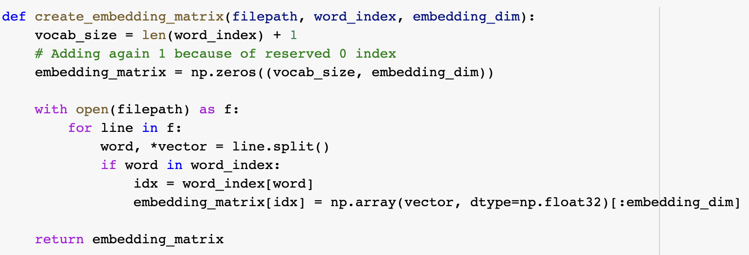
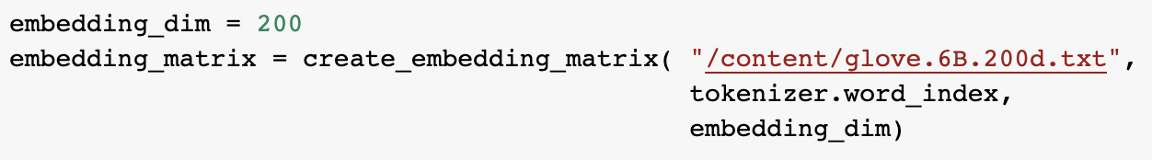
Create the embedding matrix
https://medium.com/saarthi-ai/sentence-classification-using-convolutional-neural-networks-ddad72c7048c

Slide 14
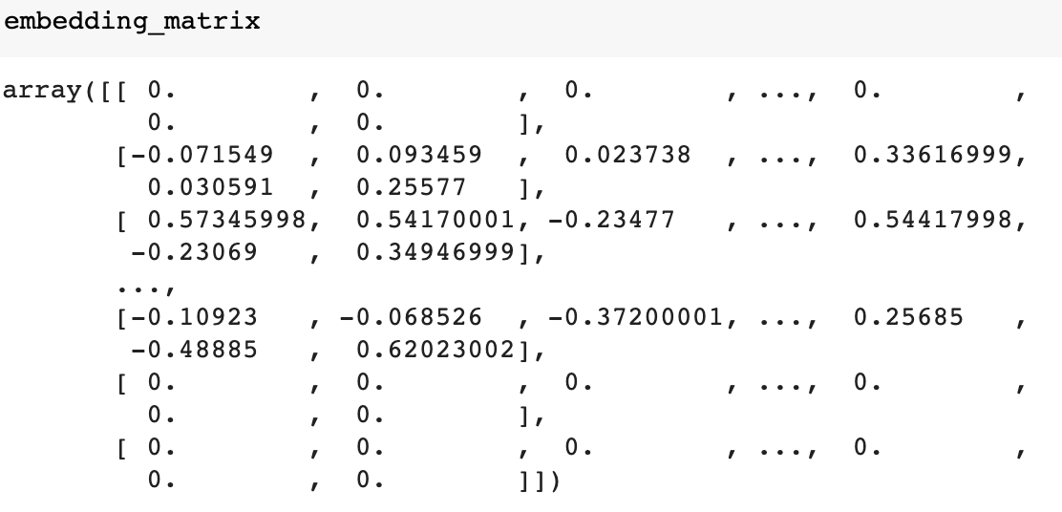
Embedding Matrix

Slide 15
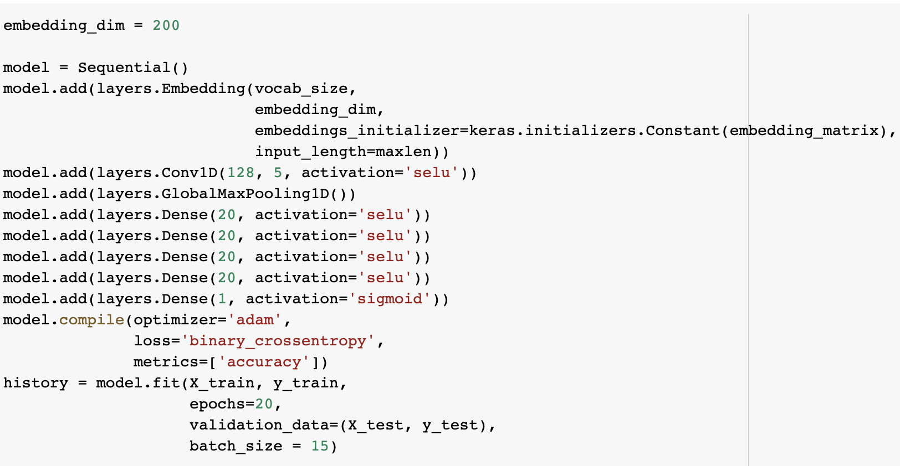
CNN model

Slide 16
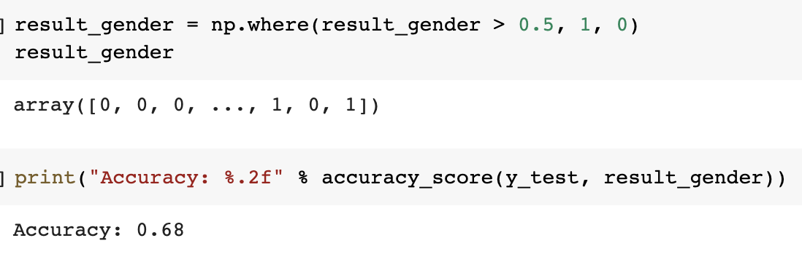
Accuracy with CNN model

Slide 17
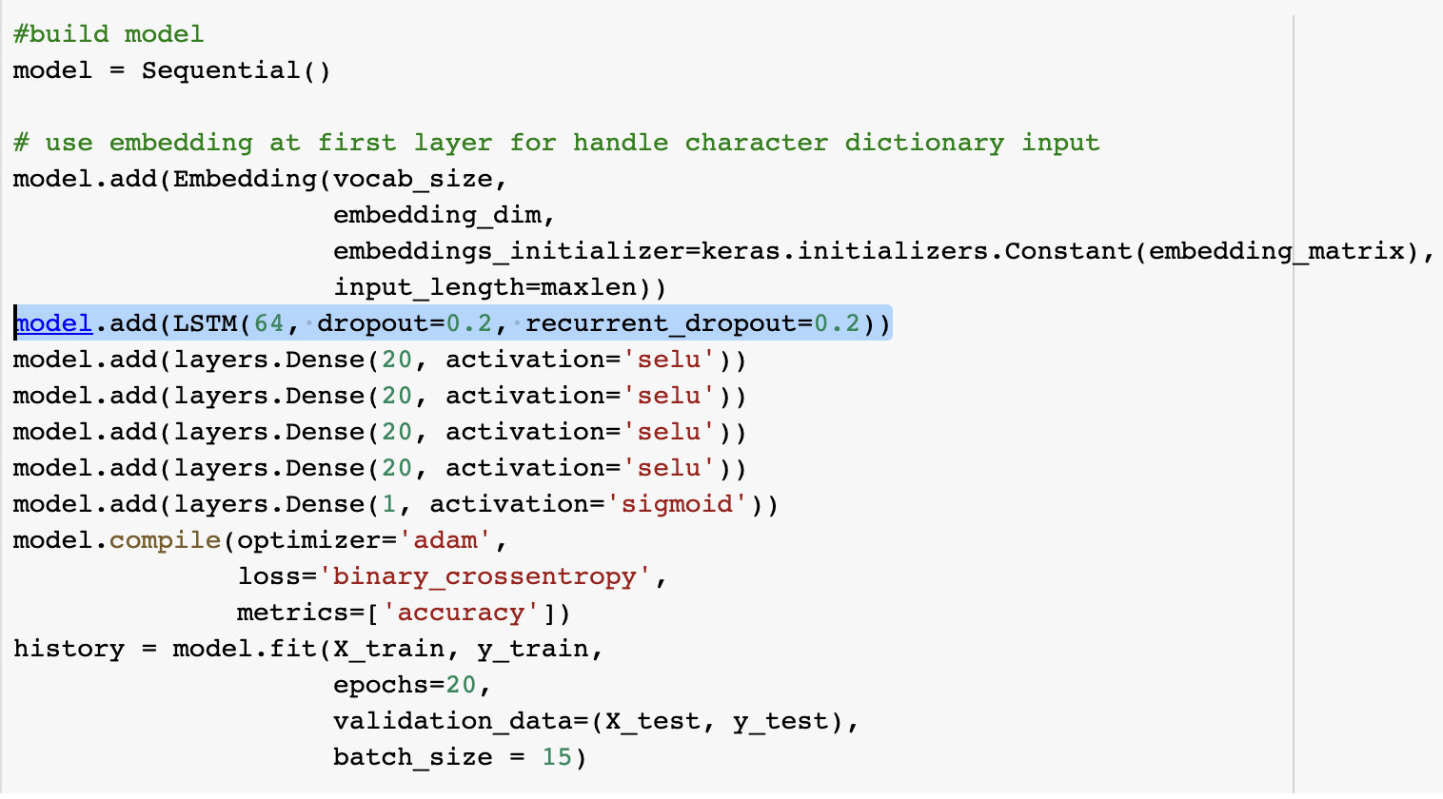
LSTM Model

Slide 18
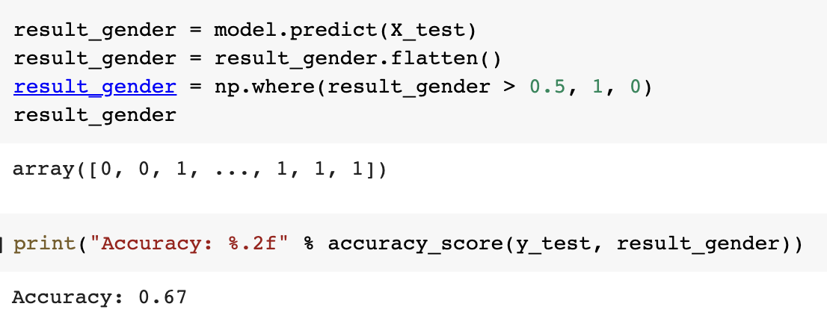
Accuracy of LSTM Model

Slide 19
Lessons Learned
Basic knowledge about how to use python/numpy and pandas to do the machine learning
Loading Data
Processing Data
Building Model
Training Model
Predicting
Knew some powerful models : LinearRegression, NB, Random Forest, CNN/LSTM, Pre-trained embedding …
Process the Text with different tools : CountVectorizer, stop words, word bagging, embedding words …

Slide 20
“Likes”
Focus on training the model for 5-big personalities.
Tried to deploy LogisticRegression, and KNeighborsRegressor
Overfitted.

Slide 21
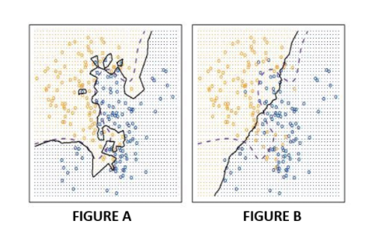
RMSE for train and test dataset
The result of KNeighborsRegressor
Reason?: The value of n_neighbors might still too small.
Source: Midterm practice problems on kNN
Train Dataset:
Ope: 0.42
Con: 0.55
Ext: 0.72
Agr: 0.49
Neu: 0.70
Test Dataset:
Ope: 0.67,
Con: 0.84
Ext: 0.85
Agr: 0.73
Neu: 0.74

Slide 22
Achievement for Likes
RandomForestClassifier
Gender: 0.75 accuracy
Age Group: 0.64 accuracy
LinearRegression
Open: 0.63 RMSE
Neurotic: 0.78 RMSE
Extrovert: 0.78 RMSE
Agreeable: 0.66 RMSE
Conscientious: 0.72 RMSE

